Slide 1
ROCKBUSTER STEALTH LLC
Online Launch strategic planning Deck

Slide 2
Introduction: Rockbuster Stealth LLC is a movie rental company that used to have stores around the world. Facing stiff competition from streaming services such as Netflix and Amazon Prime, the Rockbuster Stealth management team is planning to use its existing movie licenses to launch an online video rental service in order to stay competitive.

Slide 3
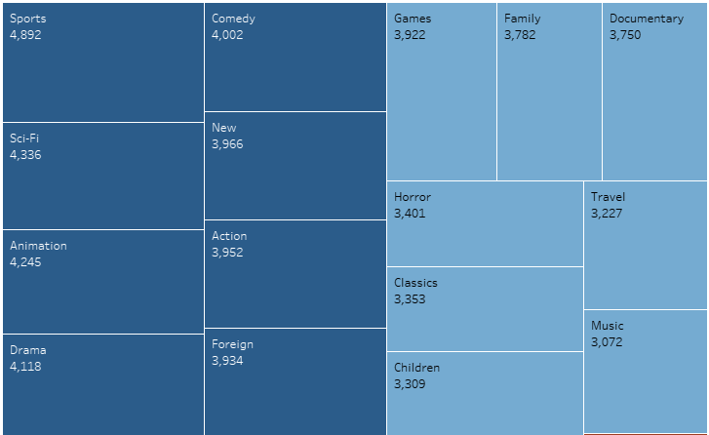
Movie Revenue by Categories
By calculating the revenue for each genre by title, we can see that the Sports, Sci-Fi, Aniamtion and Drama genres are the highest earners. Based on total revenue, however, the Sports genre has earned the most. The biggest loser is the Thriller genre, with only one title only earning $48 (Which is invisible in the visualization)

Slide 4

Key Questions and objectives
Questions to resolve:
Which movies contributed the most/least to revenue gain?
What was the average rental duration for all videos?
Which countries are Rockbuster customers based in?
Where are customers with a high lifetime value based?
Do sales figures vary between geographic regions?

Slide 5
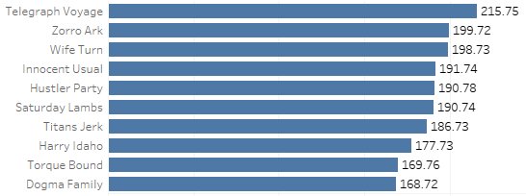
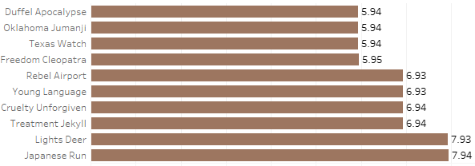
Which movies contributed the most/least to revenue gain?
TOP 10 MOVIES
Bottom 10 movies
In the bottom 10 movies, the least revenue contributed movies are Duffel Apocalypse, Oklahoma Jumanji and Texas Watch.
In the top 10 movies, the most revenue contributed movies are Telegraph Voyage and Zorro Ark.

Slide 6

What was the average rental duration for all videos?
In the above picture you can see the Minimum, Maximum and Average rental duration. The average rental duration for all videos is 5 days.

Slide 7
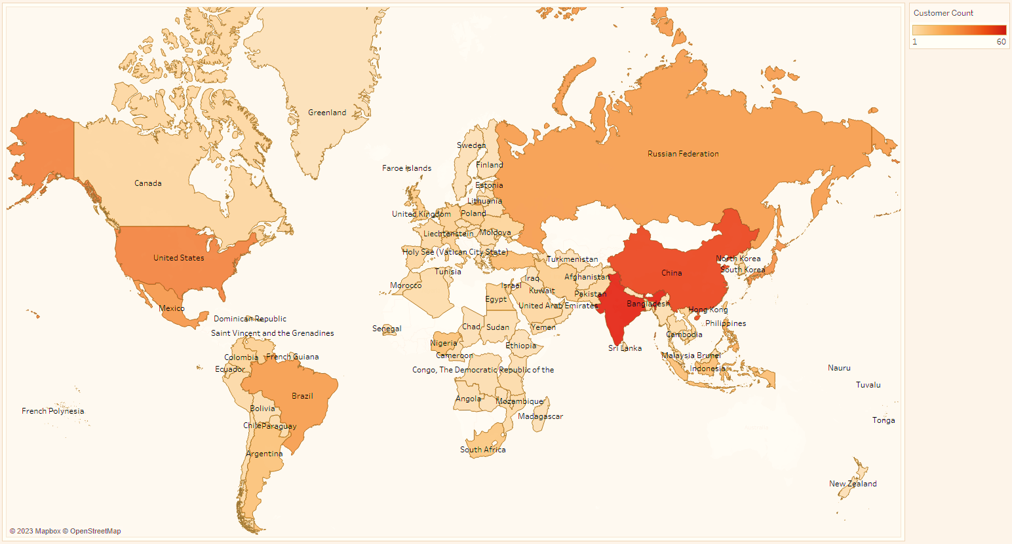
Which countries are Rockbuster customers based in?
The previous graph shows the Rockbuster serves 109 countries within 6 regions with 2 stores located in Canada and Australia.

Slide 8
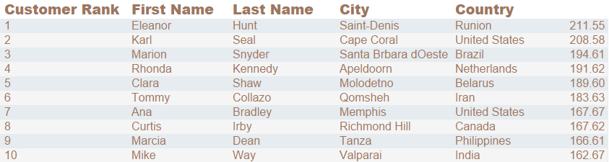
Top 10 Customers by revenue
The above graph shows the Top 10 customers by revenue.

Slide 9

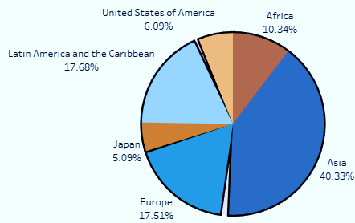
Revenue by Region
Total Revenue = $61,312
Asia, Europe and Latin America has the highest Revenue followed by Africa, US and Japan.

Slide 10
Observations:
Rental duration averages 5 days. This provides a guide for how long new content should remain available, keeping in mind that in order to retain subscribers, new content needs to be constantly made available to customers.
The average rental rate of $2.98 can be offset by competitive monthly or annual subscription options for access to all content.
Focus should be on the top income generating categories (Sports, Sci-Fi, Animation, Drama and Comedy) and rating groups (PG-13 and NC-17).
Rockbuster customers are based in many countries across the globe, with India and China at the top, followed by the U.S., Japan & Mexico, in the top 5.
The top 5 customers with a high lifetime value are based in Réunion, the United States, Brazil, the Netherlands and Belarus.
Sales figures vary greatly between geographic regions. 41%, the highest percentage of Rockbuster’s revenue, is being generated by the customers located in the region of Asia.
Currently, Rockbuster’s database includes only movies. There is also a high demand for customers who stream TV shows. In order to remain competitive Rockbuster should also expand its content to tap into that market.

Slide 11
Thank You Everyone! If anyone has questions, please reach out to: geetha.sou13@gmail.com I wish you a very nice day!

